Slide 1
Arthur Brooks
Parker Gilbert Montgomery Professor
Harvard University

Slide 2
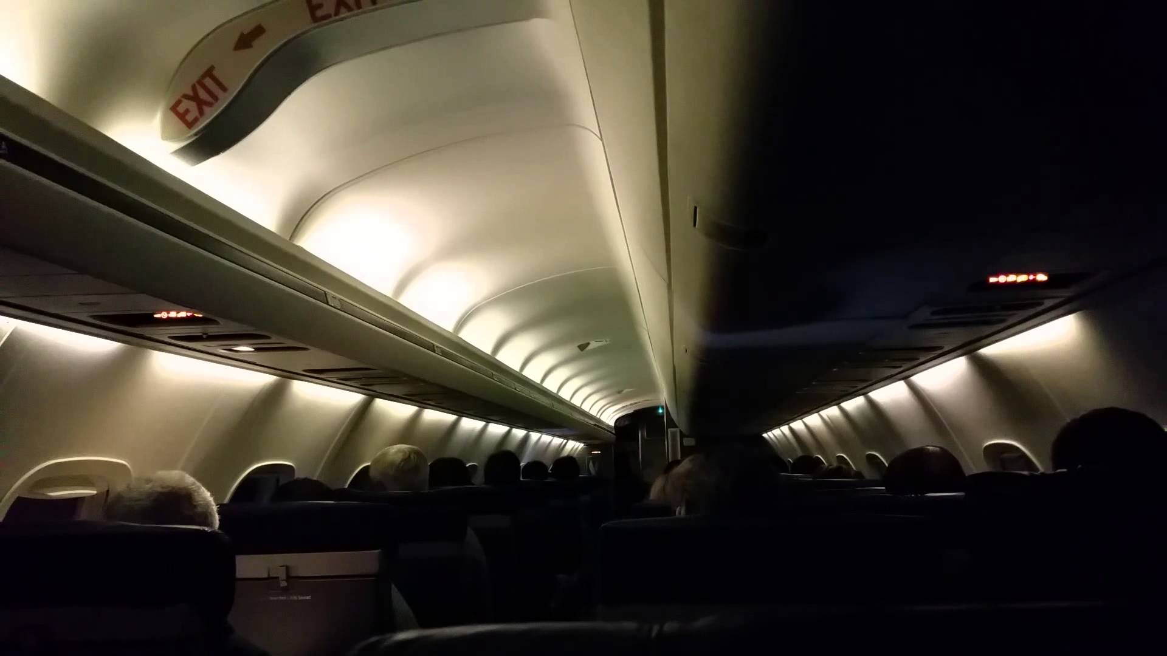
Notes:
The stranger on the plane.
I was contemplating this. Is this what I face? And selfishly thinking, “What can I do to avoid that?”
I think I found the answer, and I’m going to share it with you over the next hour.

Slide 3
Happiness as we age
BLANCHFLOWER & OSWALD (2017)

Slide 4
Happiness as we age
66
53
BLANCHFLOWER & OSWALD (2017)
Notes:
Two groups, two paths.

Slide 5
Happiness as we age
66
53
“STRIVER’S CURSE”
BLANCHFLOWER & OSWALD (2017)
Notes:
Two groups, two paths.

Slide 6
THE QUESTION:
How do I avoid the striver’s curse?

Slide 7
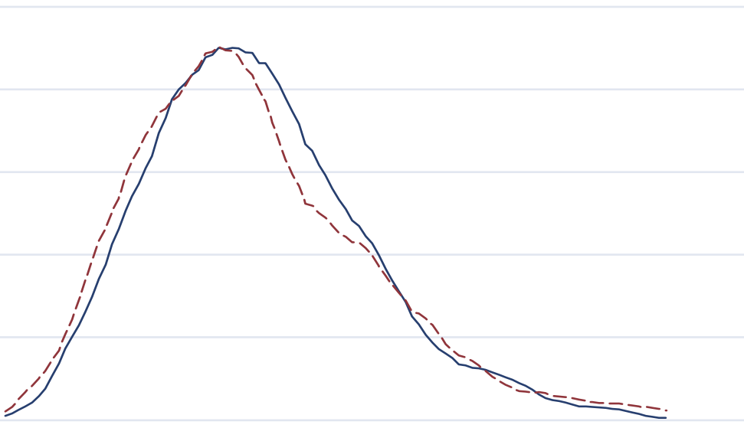
The inevitability of decline
.05
.04
.03
Frequency
.02
.01
0
20
30
40
50
60
70
80
Nobel Prize Winners
Great Inventors
Notes:
Later life appears to be especially difficult for high achievers.
Why do high achievers suffer most?
For a clue, let’s turn to the story of a great and famous man…

Slide 8
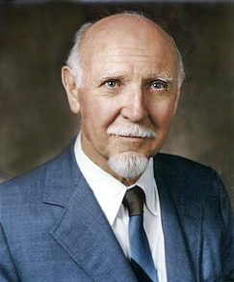
Raymond Cattell
Is there only one success curve?
Raymond Cattell 1905-1998

Slide 9
“FLUID INTELLIGENCE”
EARLY SUCCESS
Complex problem solving
Working memory
Creativity and innovation
Decreases with age

Slide 10
“CRYSTALLIZED INTELLIGENCE”
LATER SUCCESS
Accumulated knowledge and experience
Wisdom and judgment
Teaching ability
Increases with age

Slide 11
FLUID VS. CRYSTALLIZED INTELLIGENCE
BELBASE, SANZENBACHER, AND GILLIS (2015)
Notes:
Don’t try to keep doing what made you successful in your 30s and 40s. That will lead to frustration.
Use your crystallized intelligence instead.
How? Move to the right professional area later in life. Consider…

Slide 12
Get on your second curve
Early on, rely on fluid intelligence, the basis of innovation
Later, rely on crystallized intelligence—wisdom—and focus on instruction
Question: Am I sharing my wisdom?

Slide 13
Notes:
This is an empty canvas. For us in this room, this is the beginning of a piece of art. The art is produced by adding things to this canvas.
Art mirrors life, but also life mirrors art. This is metaphor for how we see a successful life. You build your life by adding ideas, activities, accomplishments, and possessions.
The Western view of happiness…get your bliss by adding stuff
But that’s not the only way to think about art, or life.
Several years ago, became interested in the key differences between Western and Eastern art. Visited the National Palace Museum in Taiwan. Priceless treasures. Hired a Chinese art historian.
My purpose: not to learn about the works, but the philosophical differences between Western and Eastern art.
He showed me this…

Slide 15
Number 1, 1949
Jackson Pollock

Slide 16
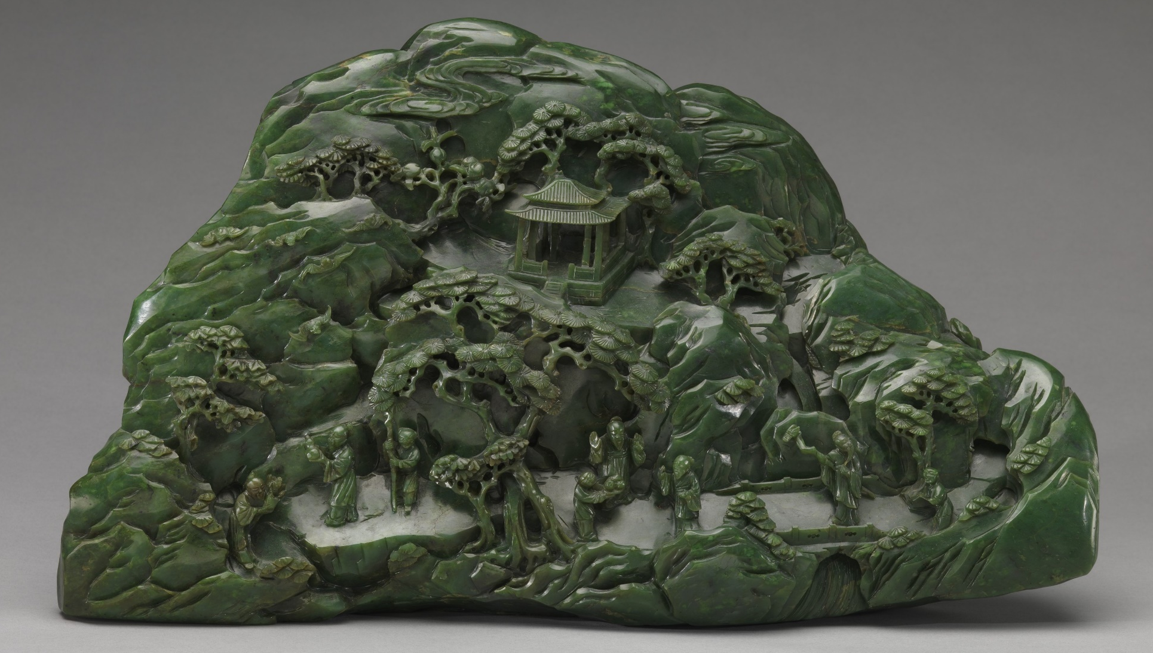

Slide 17
Satisfaction ≠ Haves
Satisfaction = Haves ÷ Wants

Slide 18
Offer up a
Reverse Bucket list

Slide 19
Manage your wants, not your haves
Early on, add to build your life and career
Later, subtract to find your true self
Ask: What do I need to subtract this year?
Notes:
SO far, I’ve been talking about you alone.

Slide 20
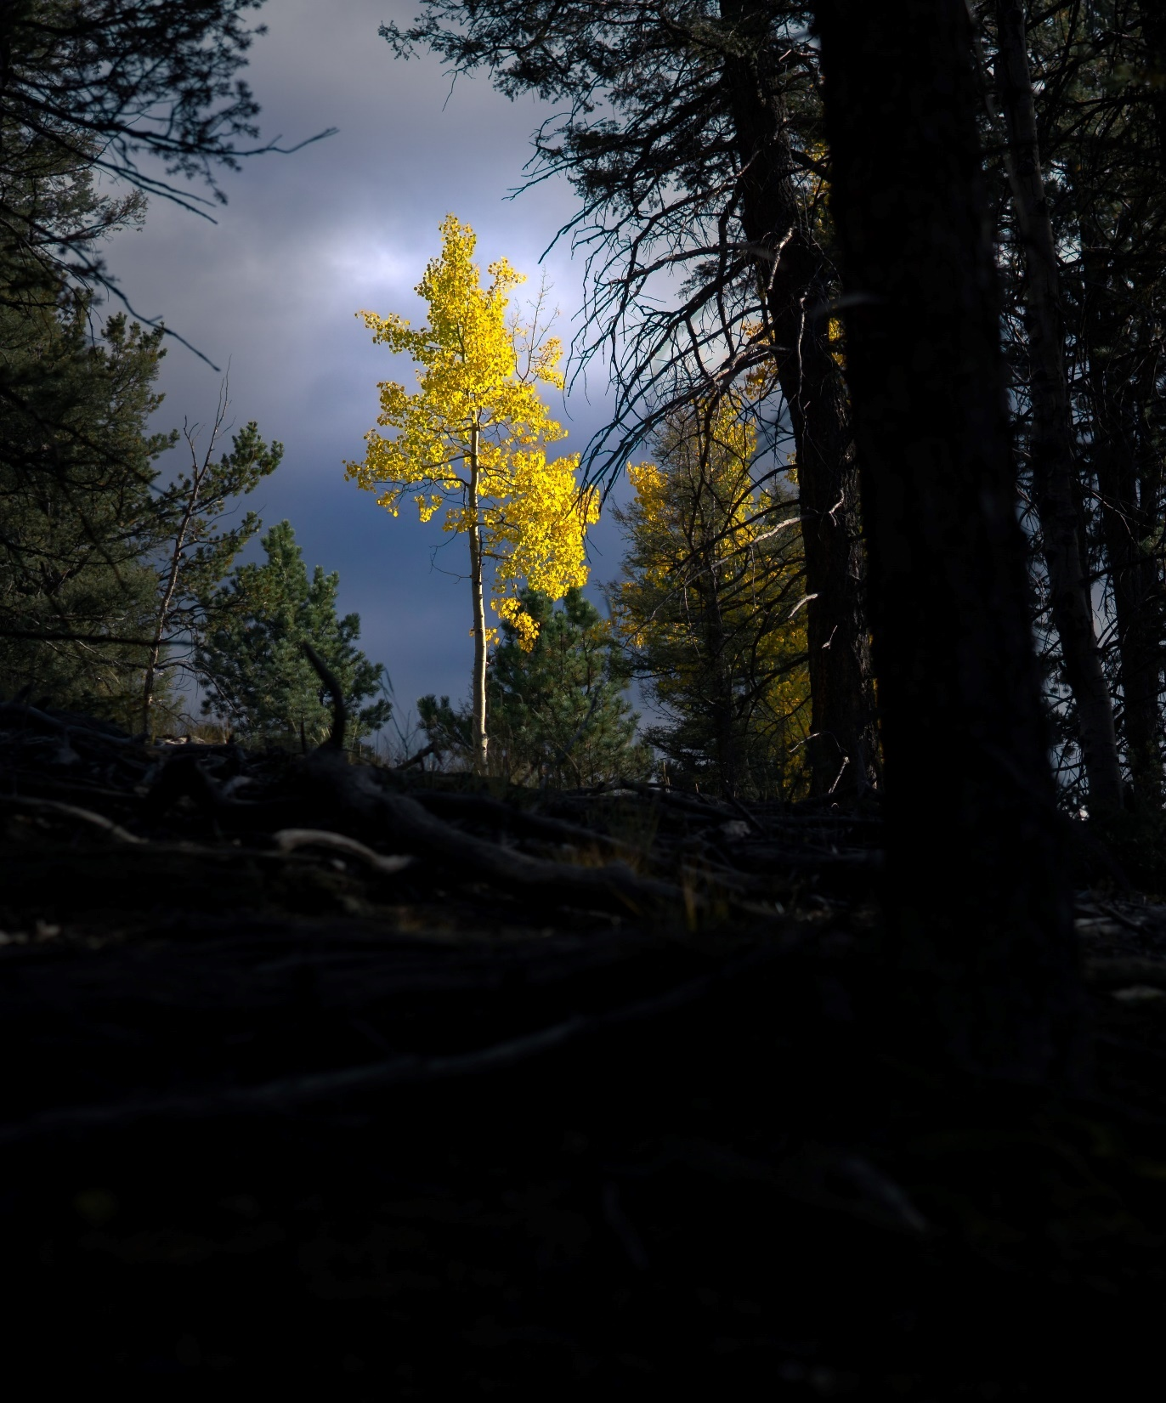
The striver’s journey is often a solitary one
He is like a tree planted by streams of water, yielding its fruit in season, whose leaf does not wither, and who prospers in all he does.
Psalm 1:3
Notes:
We tend to define our sense of unique self in terms of our individual abilities. We see ourselves in isolation, like this Aspen tree.
We sprout up, and grow to majestic heights, but ultimately cease to exist.
This metaphor is deceptive. The Aspen tree isn’t a majestic individual We don’t exist in isolation. We shouldn’t try to understand our lives in terms of our individual achievements. Rather, our lives are the sum of our relationships.
Think of it like this…
This metaphor is deceptive. The Aspen tree isn’t a majestic individual We don’t exist in isolation. We shouldn’t try to understand our lives in terms of our individual achievements. Rather, our lives are the sum of our relationships.
Think of it like this…

Slide 21
Notes:
Largest living organism is the Aspen tree, stands of which are one plant with a single root system. “Individual” trees are
Pando, in Utah, is 106 acres, and weighs 6m kilograms.
We all have a common root system of our humanity—we are part of one moral organism. A change in one member is not a loss, but simply a change in the general community around us. As I decline in abilities, my children come into their own, my grandchildren are born. Meanwhile, I share my change with my spouse and my friends. It’s all the cycle of love in intertwined lives.
What is the very best strategy as I go through life? It is to surround myself with the people I love, like one changing tree in a stand of aspens. Then, a decline is simply a change in the ecosystem of love in my life.

Slide 22
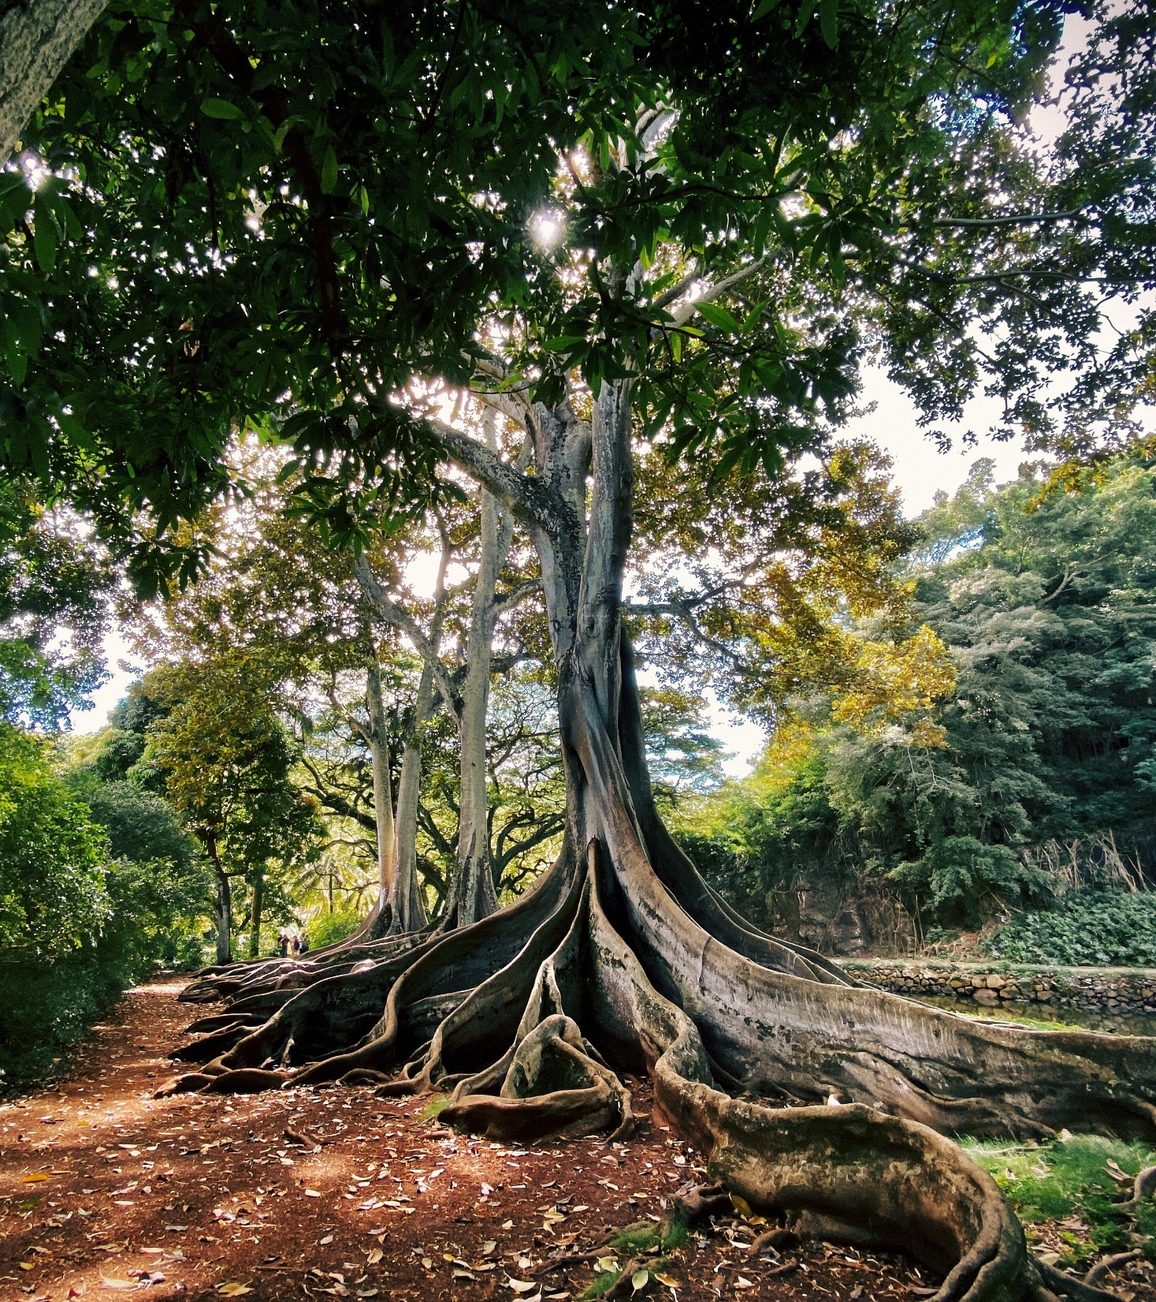
Don’t go it alone
Your true self is not the sum of your achievements. It is the sum of the love for the people in your life.
Notes:
SO far, I’ve been talking about you alone.

Slide 23
Why doing this is so hard
The curse of specialness

Slide 24
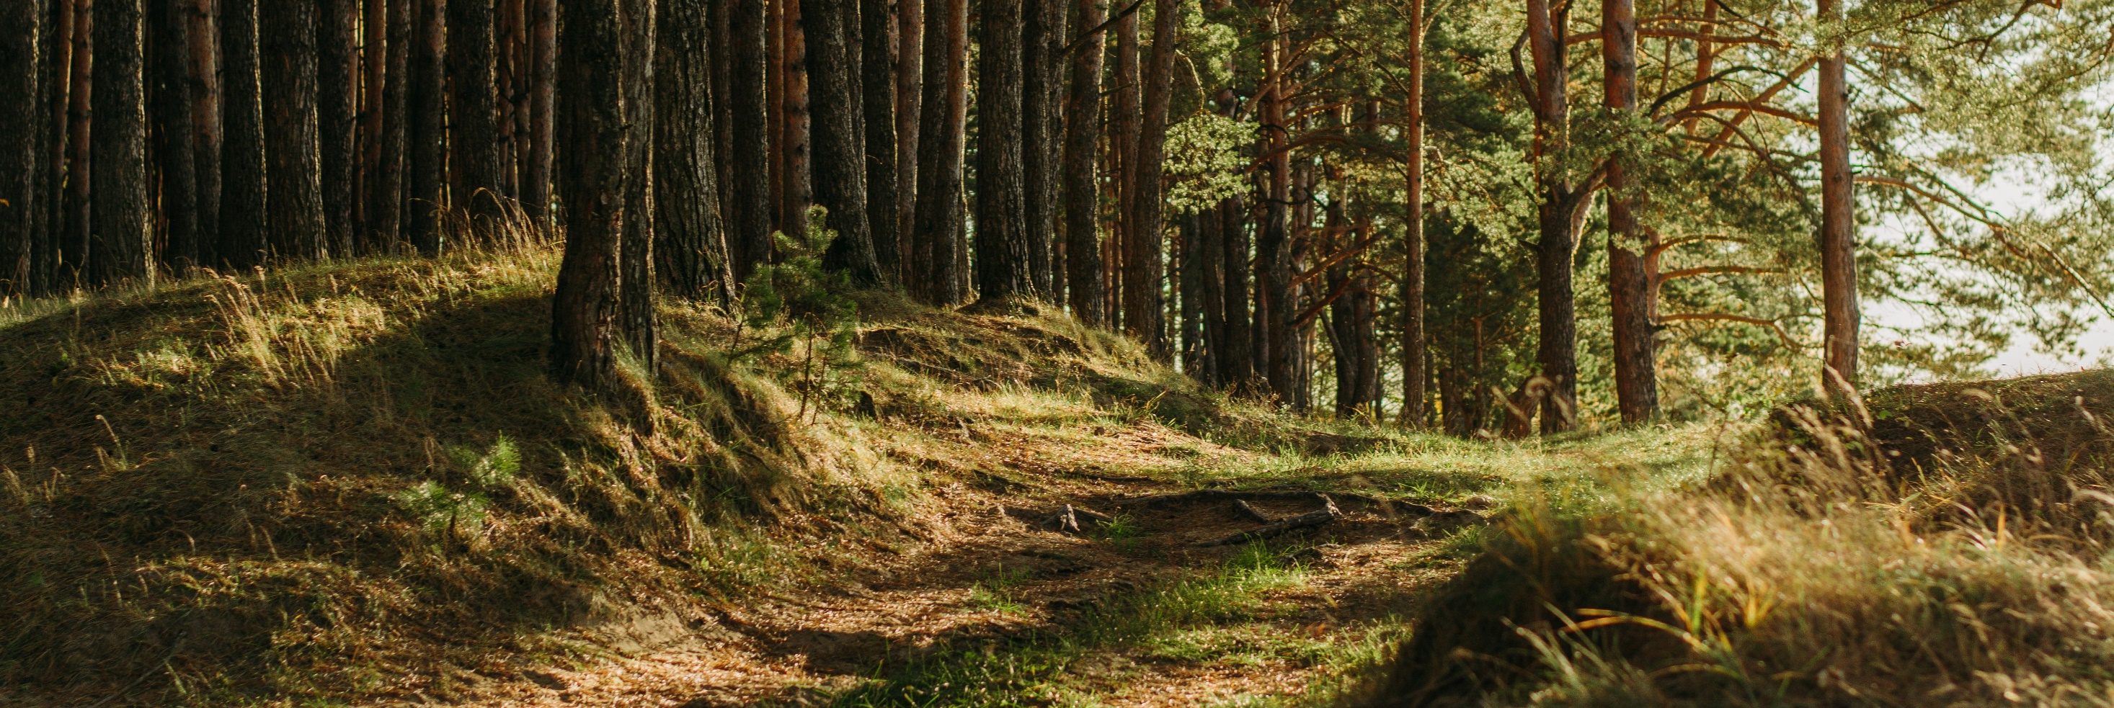
Four lessons
01
02
03
04
Get on your second curve
Manage your wants
Tend to
your roots
Happy
>
Special

Slide 25
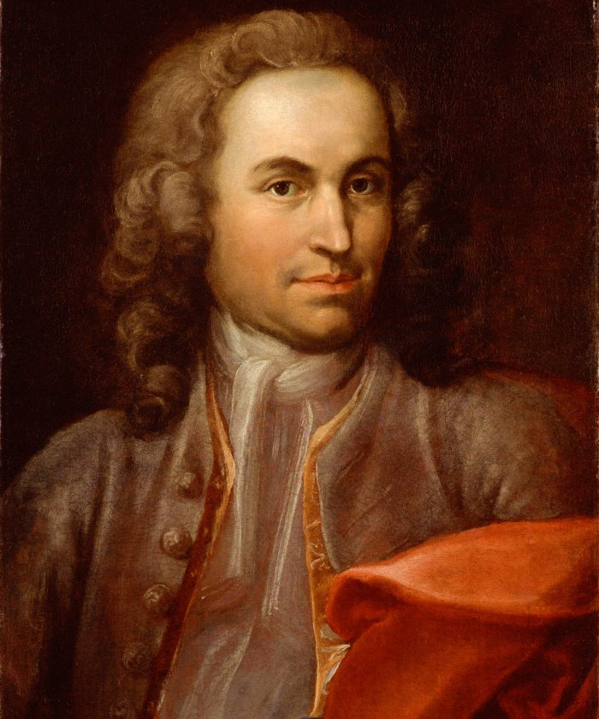
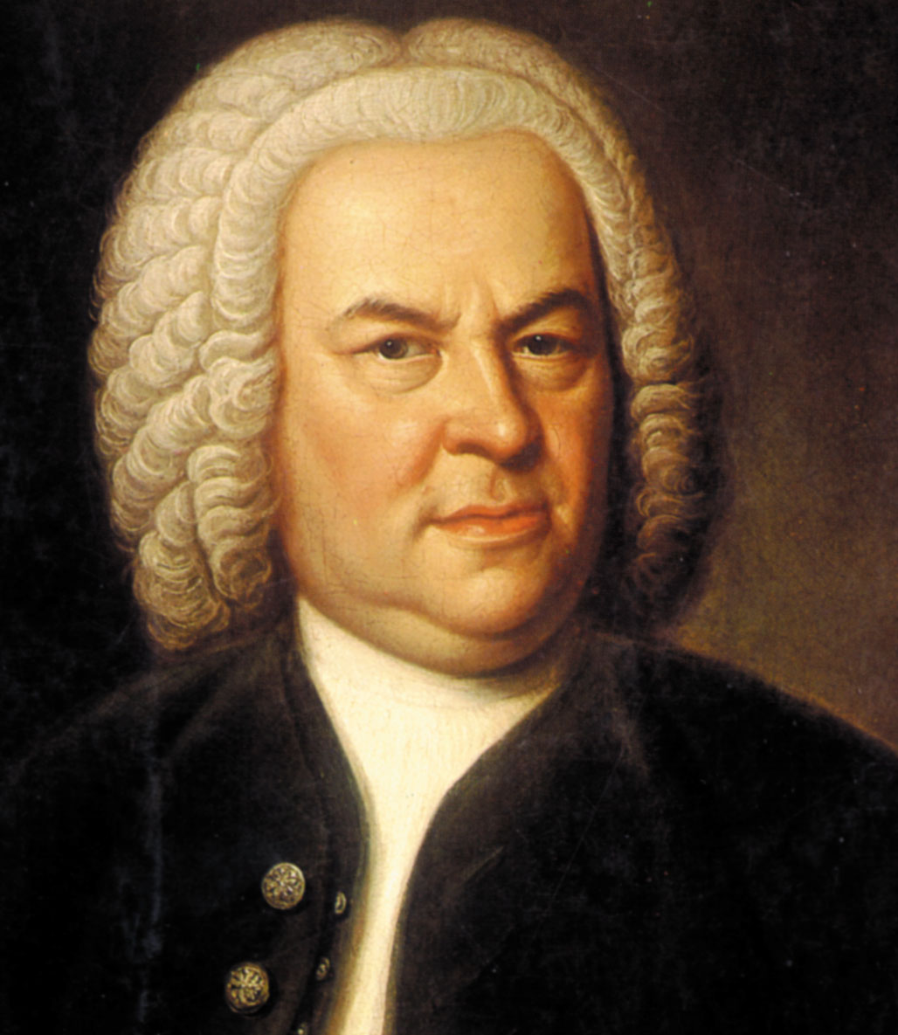
The aim and final end of all music is nothing less than the glorification of God and the enjoyment of man.”
Johann Sebastian Bach, 1685-1750
Notes:
Think of this as your “Sherlock Holmes Brain”
But Bach didn’t rely on this as he aged. Instead, he moved to something called “crystallized intelligence”

Slide 26
For more information, visit: arthurbrooks.com/resources
@arthurcbrooks @arthurbrooks

Slide 27
© 2023 ACB Ideas: This copyrighted material may ONLY be copied, reproduced, distributed, and/or transmitted if (i) solely for personal use in connection with educational or training purposes in accordance with the principles set forth in this material, and (ii) with complete attribution to ACB Ideas LLC. Under no circumstances may this material (in whole or in part or any derivative thereof) be used for commercial gain. Do not copy, reproduce, distribute, transmit, modify, create derivative works, or in any other way exploit any part of this material except as set forth above.

